Slide 1

Emotion Recognition and Expression in Text
SUBMITTED TO - MR.K GOKULAKRISHNAN

Slide 2



INTRODUCTION
Emotions are universal, but the way we express them varies from culture to culture. This project aims to create a system that takes into consideration these variations in order to accurately recognize emotions in text.
Recognizing and expressing emotions across multiple languages involves understanding linguistic and cultural variations in emotional expression. This project proposes a model that accurately recognizes and expresses emotions in text across diverse languages.

Slide 3

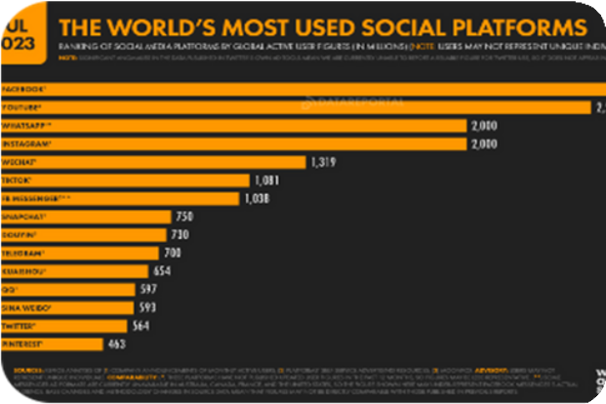


IMPLICATIONS IN REAL LIFE
BUSINESS
SOCIAL MEDIA
PHILANTHROPY
TRAVEL
The ability to accurately understand emotions across different languages is essential in a globalized business environment.
A multilingual system could help social media platforms better understand the emotions behind posts in different languages, resulting in more accurate and relevant content for users.
A multilingual emotion recognition system could help charities better understand the feelings and needs of people from different parts of the globe.
Travelers could benefit from using this system to understand and express emotions in foreign languages, helping them connect with locals and navigate new environments.

Slide 4
Challenges of Emotion Recognition and Expression
1.Translation Accuracy
2.Cultural Differences
3.Language Complexity
Translation errors can cause misunderstandings or misinterpretations of emotions in text.
Emotional expressions may differ across cultures, making it difficult to accurately recognize emotions in text.
Some languages may have more complex emotional expressions than others, requiring a more sophisticated system for detection and expression.

Slide 5
The Proposed Model
1.Language-Specific Emotional Expression Generation
2.Emotion Detection and Sentiment Analysis
3.Validation and Refinement
This step generates language- specific emotional expressions that accurately convey the emotions detected in the previous step.
Utilizing natural language processing techniques, this step identifies emotions and evaluates the overall sentiment of the text.
Testing and refinement are done to ensure that the multilingual model accurately detects and expresses emotions in various languages and contexts.

Slide 6
Emotion Detection and Sentiment Analysis
1.Emotion Detection 2.Sentiment Analysis 3.Machine Learning
This step involves analyzing text to determine which emotions are being expressed and to what degree.
Using natural language processing, this step determines the overall sentiment of the text.
The system uses machine learning algorithms to improve the accuracy of emotion detection and sentiment analysis over time.

Slide 7
Language-Specific Emotional Expression Generation
1.Language-Specific Rules
This step generates emotion- specific expressions based on the rules and norms of the target language.
2.Contextual Analysis 3.Machine Learning
The system takes into account the context of the text to ensure that the generated expressions are appropriate and accurate.
The system learns and adapts over time based on user feedback and real-world usage.

Slide 8
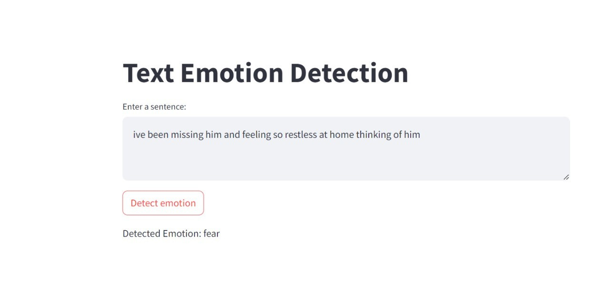
Here Are Few Sample Output
Detected Emotion As - FEAR

Slide 9
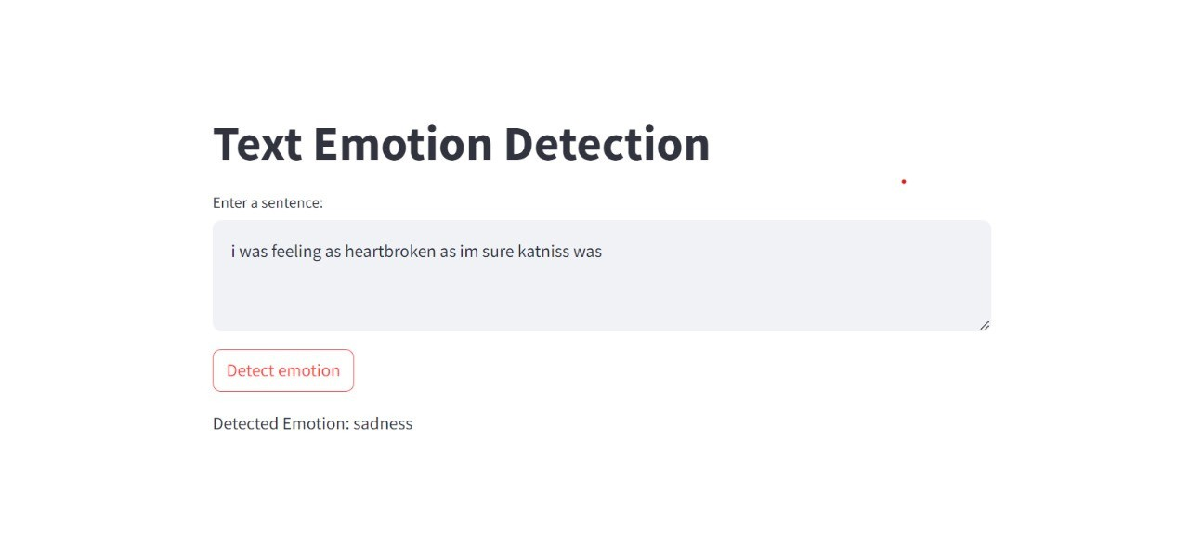
Here Are Few Sample Output
Detected Emotion As - SADNESS

Slide 10
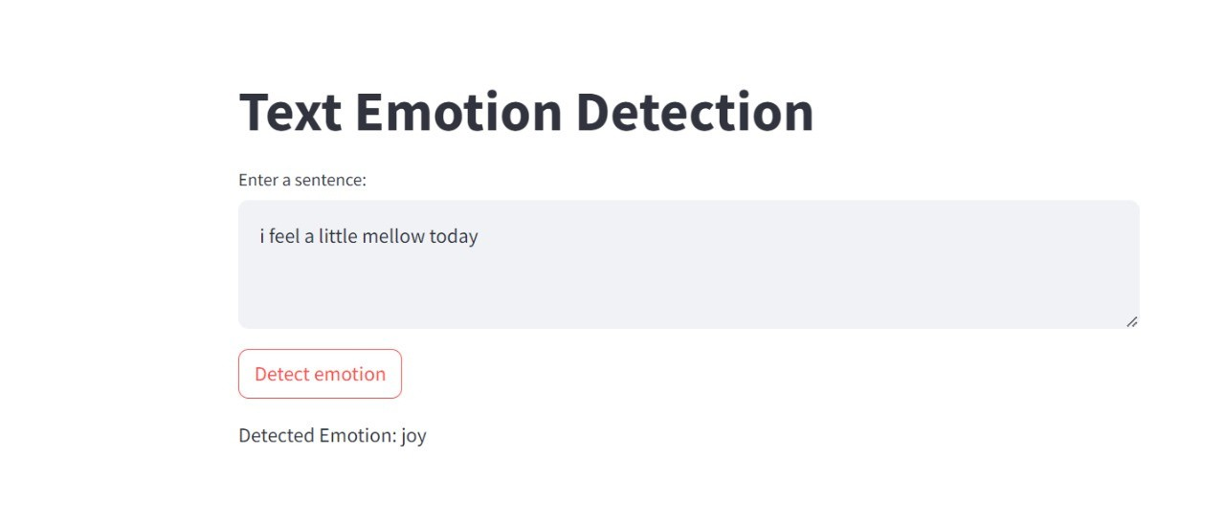
Here Are Few Sample Output
Detected Emotion As - JOY

Slide 11
CONCLUSION
A multilingual emotion recognition and expression system has the potential to revolutionize how we communicate and connect with people from different cultures and languages. By accurately detecting and expressing emotions in text, we can better understand each other and build stronger relationships.

Slide 12
THANK YOU VERY MUCH!

